Slide 1
Azure Kubernetes Service

Slide 2
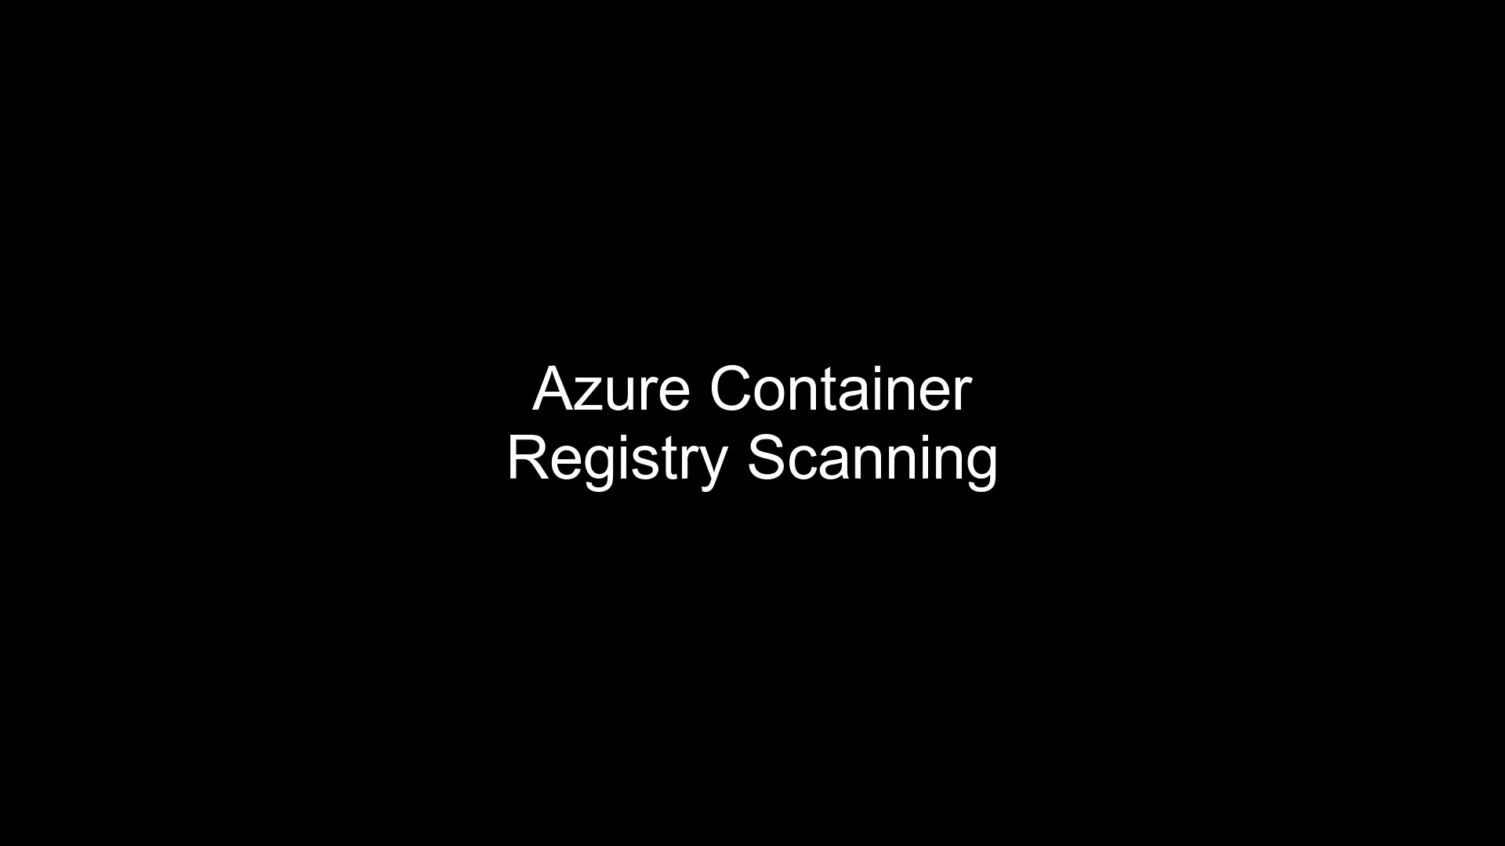

Slide 3


Slide 4
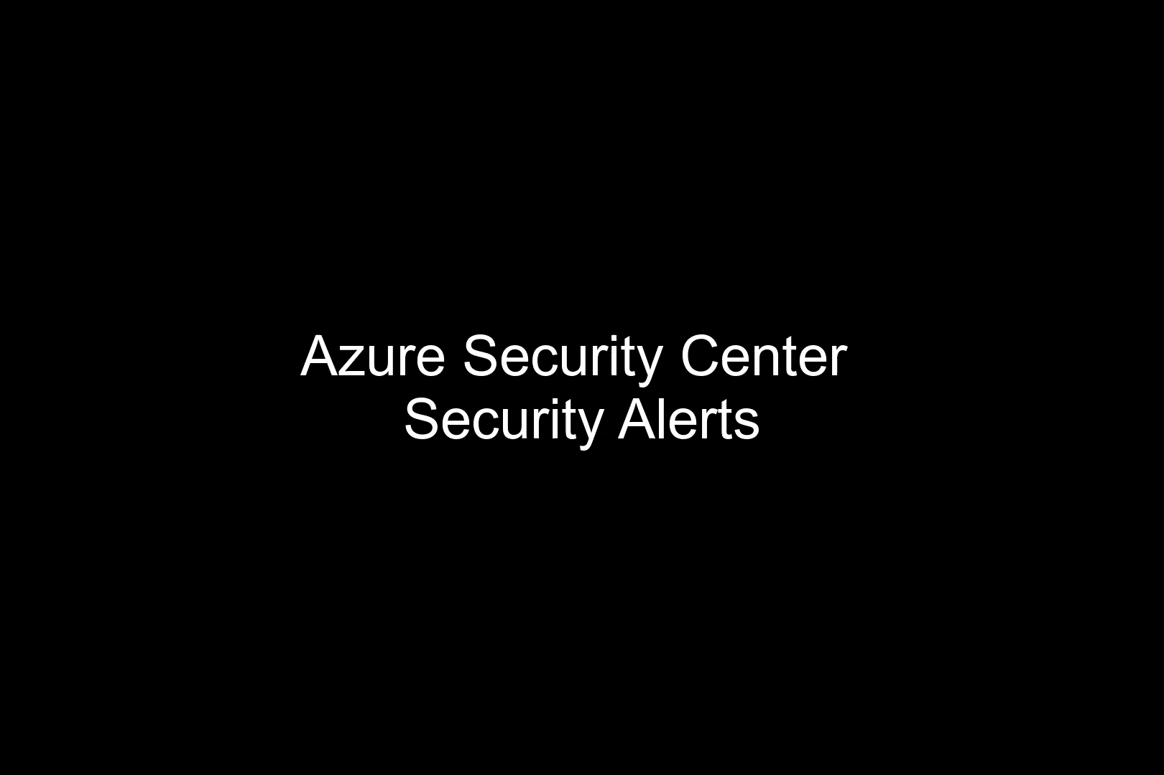

Slide 5


Slide 6
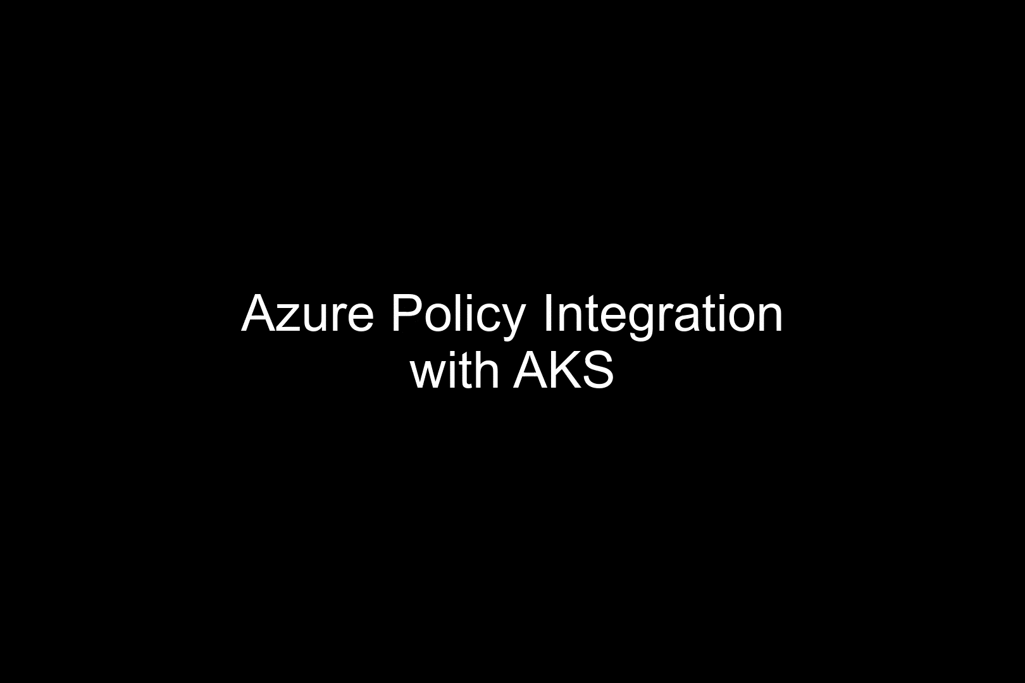

Slide 7
For setup instructions to run these demos live, check out
https://github.com/sakthi-vetrivel/aks-demos
https://aka.ms/aks/secure

